Slide 1
Completing the Accounting Cycle

Slide 2
Study Objectives
Prepare a worksheet.
Explain the process of closing the books.
Describe the content and purpose of a post-closing trial balance.
State the required steps in the accounting cycle.
Explain the approaches to preparing correcting entries.
Identify the sections of a classified balance sheet.
Notes:
1. On the topic, “Challenges Facing Financial Accounting,” what did the AICPA Special Committee on Financial Reporting suggest should be included in future financial statements?
Non-financial Measurements (customer satisfaction indexes, backlog information, and reject rates on goods purchases).
Forward-looking Information
Soft Assets (a company’s know-how, market dominance, marketing setup, well-trained employees, and brand image).
Timeliness (no real time financial information)

Slide 3

Completing the Accounting Cycle
Using a Worksheet
Closing the Books
Summary of Accounting Cycle
Classified Balance Sheet
Steps in preparation
Preparing financial statements
Preparing adjusting entries
Preparing closing entries
Posting closing entries
Preparing a post-closing trial balance
Reversing entries—An optional step
Correcting entries—An avoidable step
Current assets
Long-term investments
Property, plant, and equipment
Intangible assets
Current liabilities
Long-term liabilities
Owner’s equity
Notes:
Service Cost - Actuaries compute service cost as the present value of the new benefits earned by employees during the year. Future salary levels considered in calculation.
Interest on Liability - Interest accrues each year on the PBO just as it does on any discounted debt.
Actual Return on Plan Assets - Increase in pension funds from interest, dividends, and realized and unrealized changes in the fair market value of the plan assets.
Amortization of Unrecognized Prior Service Cost - The cost of providing retroactive benefits is allocated to pension expense in the future, specifically to the remaining service-years of the affected employees.
Gain or Loss - Volatility in pension expense can be caused by sudden and large changes in the market value of plan assets and by changes in the projected benefit obligation. Two items comprise the gain or loss:
difference between the actual return and the expected return on plan assets and,
amortization of the unrecognized net gain or loss from previous periods

Slide 4

Using A Worksheet
Worksheet
  A multiple-column form used in preparing financial statements.
  Not a permanent accounting record.
  Five step process.
  Use of worksheet is optional.
SO 1 Prepare a worksheet.

Slide 5
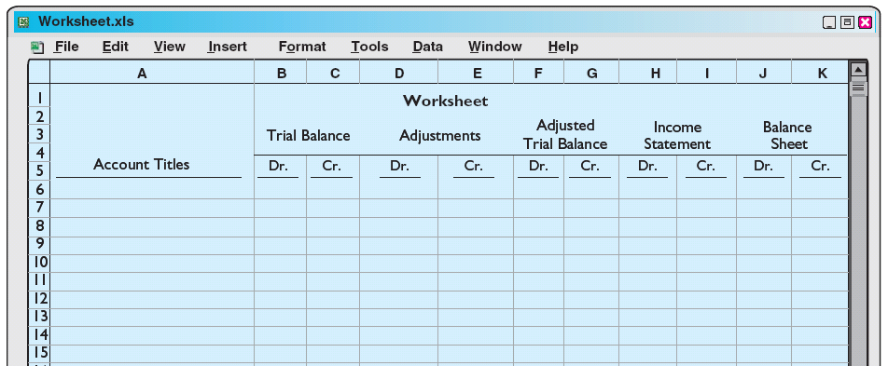
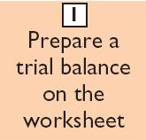
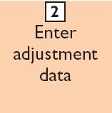
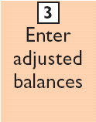
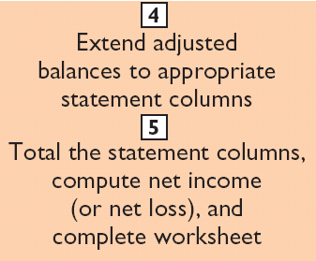
Steps in Preparing a Worksheet
Illustration 4-1
SO 1 Prepare a worksheet.

Slide 6
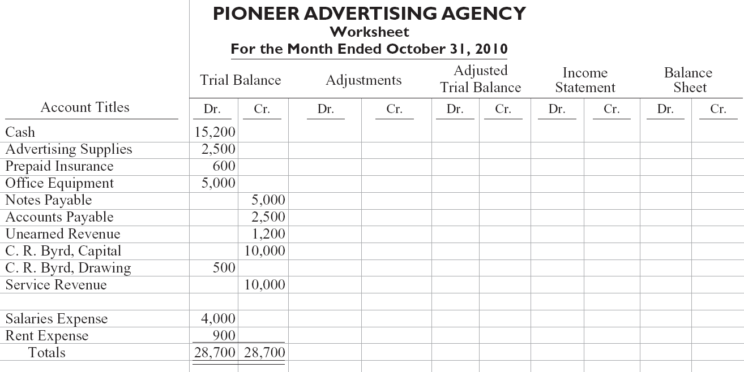
Steps in Preparing a Worksheet
Illustration:
Illustration 4-2
Preparing a trial balance
SO 1 Prepare a worksheet.

Slide 7
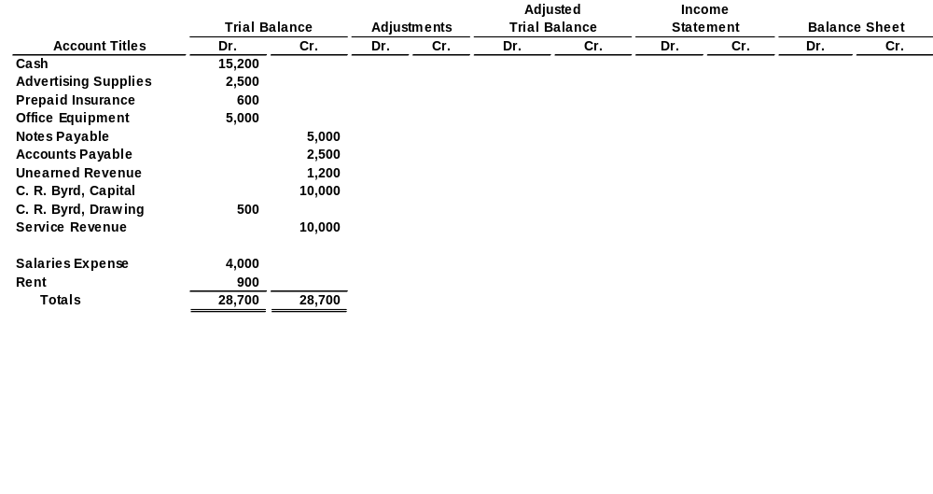
Steps in Preparing a Worksheet
1. Prepare a Trial Balance on the Worksheet
Trial balance amounts come directly from ledger accounts.
Include all accounts with balances.
SO 1 Prepare a worksheet.

Slide 8
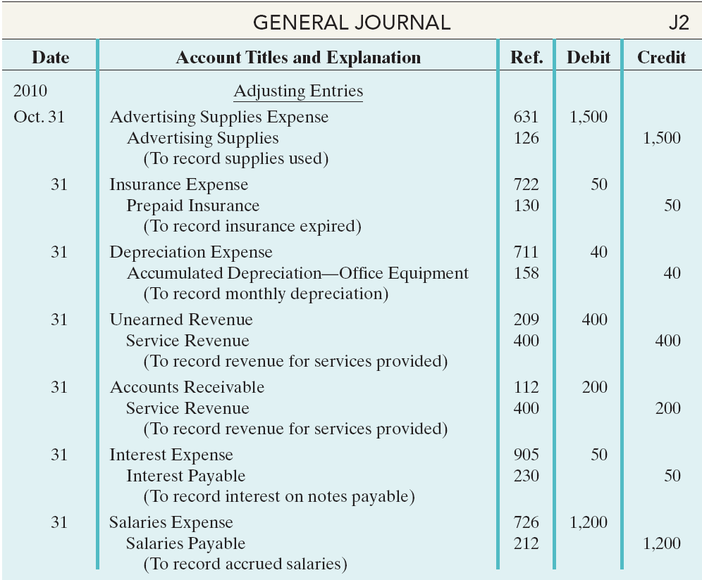
Steps in Preparing a Worksheet
Illustration 3-22
General journal showing adjusting entries
Adjusting Journal Entries (Chapter 3)
SO 1 Prepare a worksheet.

Slide 9
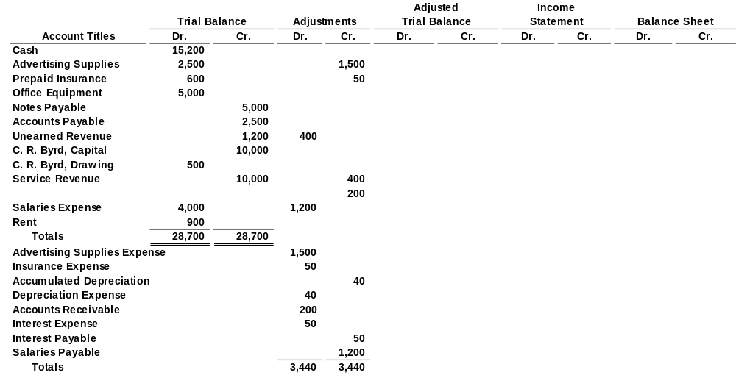
Steps in Preparing a Worksheet
2. Enter the Adjustments in the Adjustments Columns
(a)
(b)
Adjustments Key:
(a) Supplies Used.
(b) Insurance Expired.
(c) Depreciation Expensed.
(d) Service Revenue Earned.
(e) Service Revenue Accrued.
(f) Interest Accrued.
(g) Salaries Accrued.
(d)
(d)
(g)
(e)
(a)
(b)
(c)
(c)
(e)
Enter adjustment amounts, total adjustments columns,
and check for equality.
(f)
(f)
(g)
Add additional accounts as needed.
SO 1 Prepare a worksheet.

Slide 10
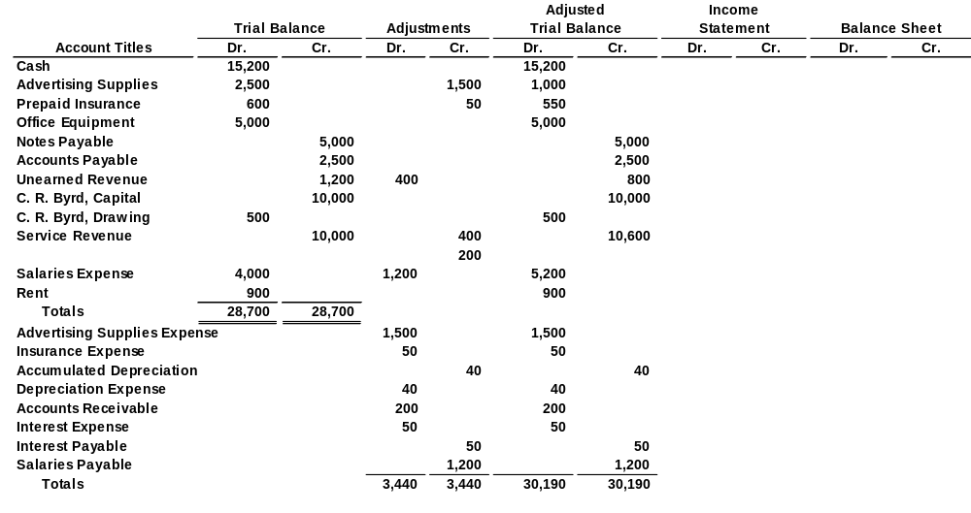
Steps in Preparing a Worksheet
3. Complete the Adjusted Trial Balance Columns
(a)
(b)
(d)
(d)
(g)
(e)
(a)
(b)
(c)
(c)
(e)
(f)
(f)
(g)
Total the adjusted trial balance columns and check for equality.
SO 1 Prepare a worksheet.

Slide 11
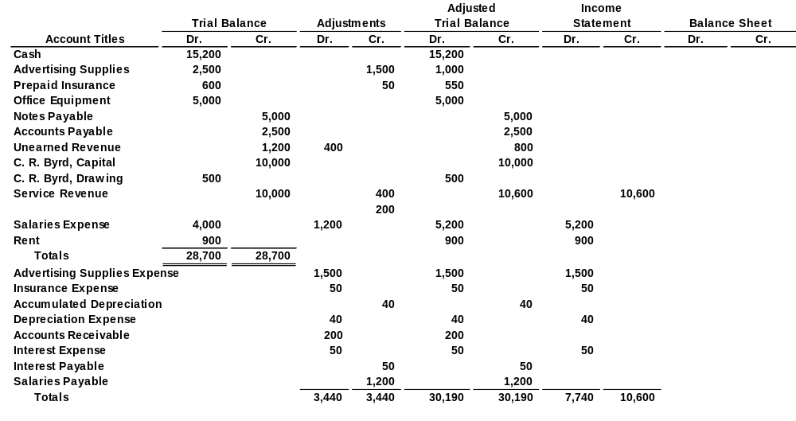
Steps in Preparing a Worksheet
4. Extend Amounts to Financial Statement Columns
(a)
(b)
(d)
(d)
(g)
(e)
(a)
(b)
(c)
(c)
(e)
(f)
(f)
(g)
Extend all revenue and expense account balances to the income statement columns.
SO 1 Prepare a worksheet.

Slide 12
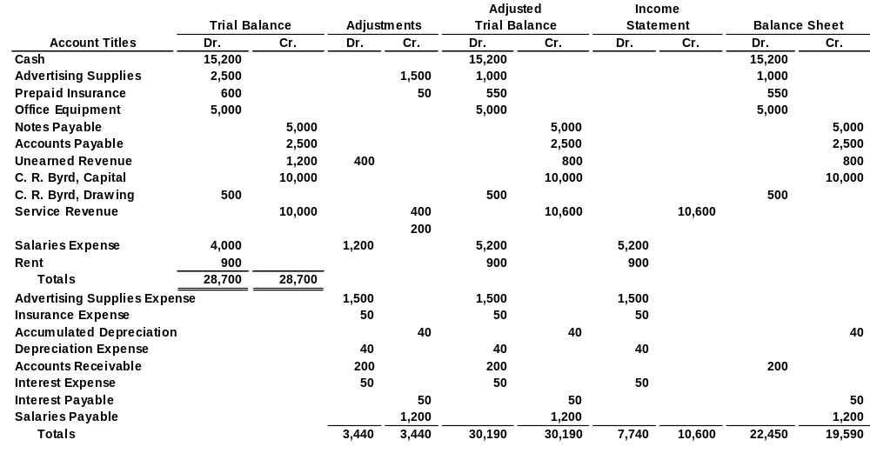
Steps in Preparing a Worksheet
4. Extend Amounts to Financial Statement Columns
(a)
(b)
(d)
(d)
(g)
(e)
(a)
(b)
(c)
(c)
(e)
(f)
(f)
(g)
Extend all asset, liability, and equity account balances to the balance sheet columns.
SO 1 Prepare a worksheet.

Slide 13
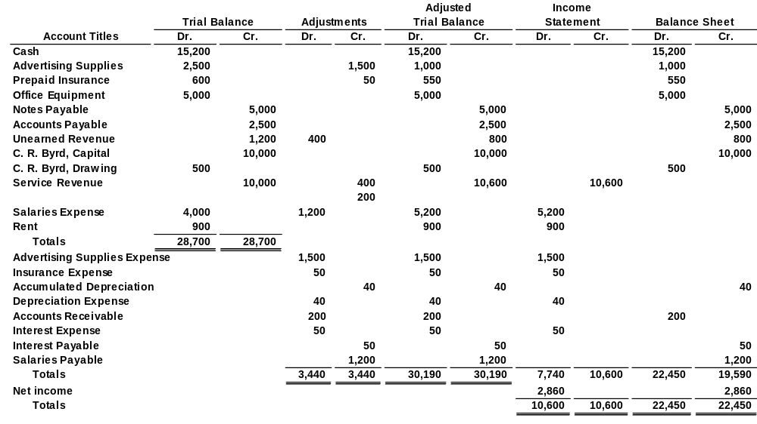
Steps in Preparing a Worksheet
5. Total Columns, Compute Net Income (Loss)
(a)
(b)
(d)
(d)
(g)
(e)
(a)
(b)
(c)
(c)
(e)
(f)
(f)
(g)
Compute Net Income or Net Loss.
SO 1 Prepare a worksheet.

Slide 14
Steps in Preparing a Worksheet
Review Question
Net income is shown on a worksheet in the:
  income statement debit column only.
  balance sheet debit column only.
  income statement credit column and balance sheet debit column.
  income statement debit column and balance sheet credit column.
SO 1 Prepare a worksheet.

Slide 15
Preparing Financial Statements from a Worksheet
Worksheet
  Income statement is prepared from the income statement columns.
  Balance sheet and owner’s equity statement are prepared from the balance sheet columns.
Companies journalize and post adjusting entries.
SO 1 Prepare a worksheet.

Slide 16
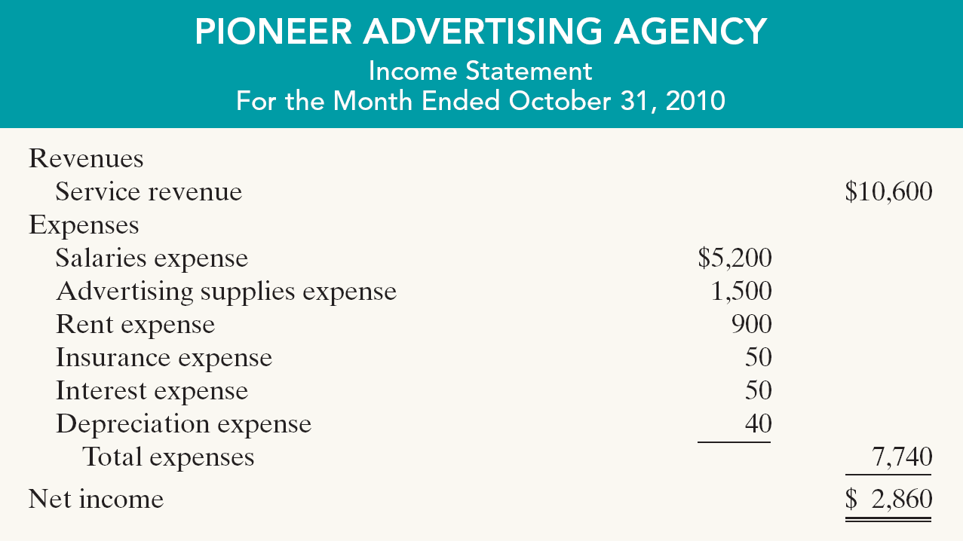
Preparing Financial Statements from a Worksheet
Illustration 4-4
SO 1 Prepare a worksheet.

Slide 17
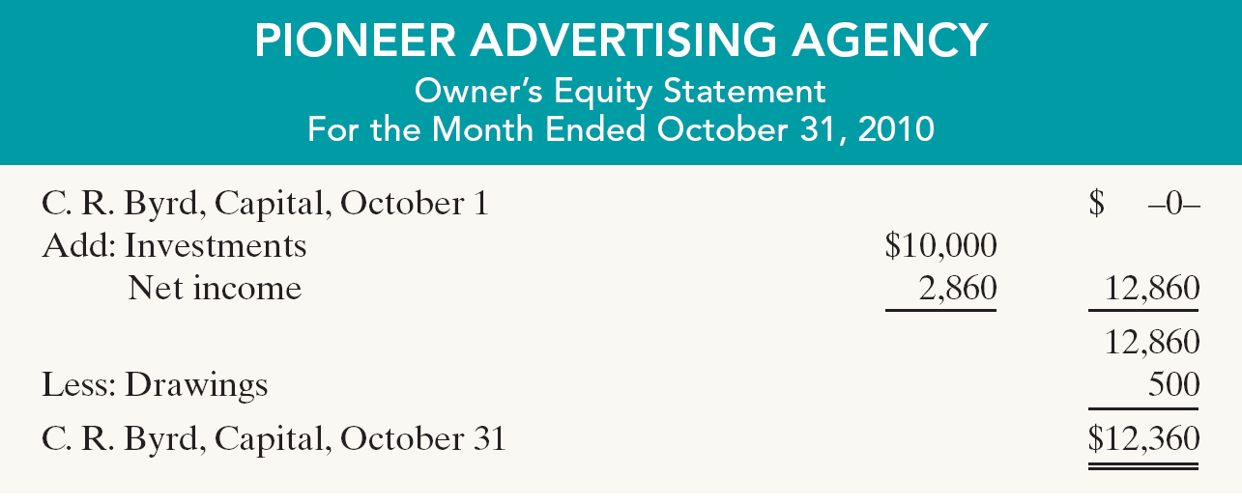
Preparing Financial Statements from a Worksheet
Illustration 4-4
SO 1 Prepare a worksheet.

Slide 18
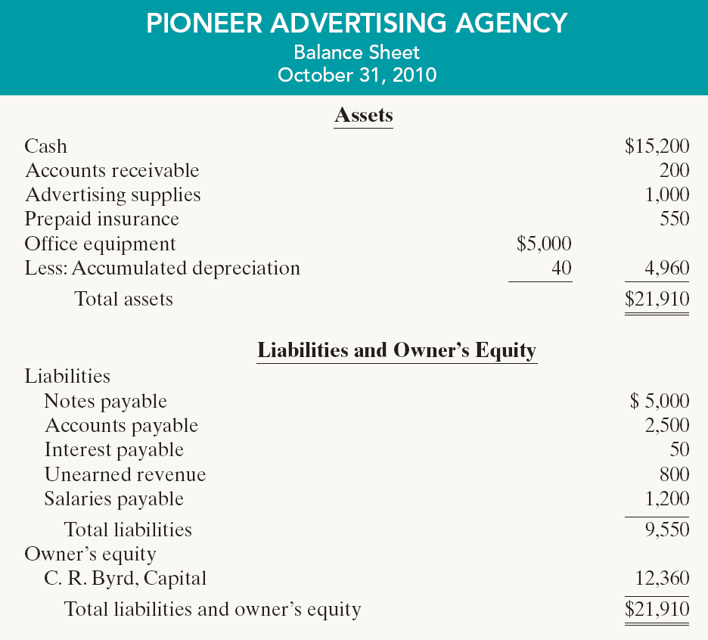
Preparing Financial Statements from a Worksheet
Illustration 4-4

Slide 19
Preparing Adjusting Entries from a Worksheet
Adjusting Entries
  The adjusting entries are prepared from the adjustments columns of the worksheet.
  Journalizing and posting of adjusting entries follows the preparation of financial statements when a worksheet is used.
SO 1 Prepare a worksheet.

Slide 20
Preparing Adjusting Entries from a Worksheet
Illustration 3-22
General journal showing adjusting entries
Adjusting Journal Entries (Chapter 3)
SO 1 Prepare a worksheet.

Slide 21
Preparing Adjusting Entries from a Worksheet
Discussion Question
Q4-2. Explain the purpose of the worksheet.
See notes page for discussion
SO 1 Prepare a worksheet.
Notes:
Question 4-2 (textbook)
2. The worksheet is merely a device used to make it easier to prepare adjusting entries and the financial statements.

Slide 22
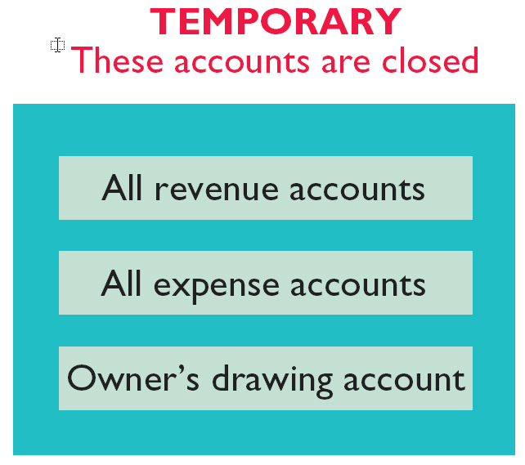
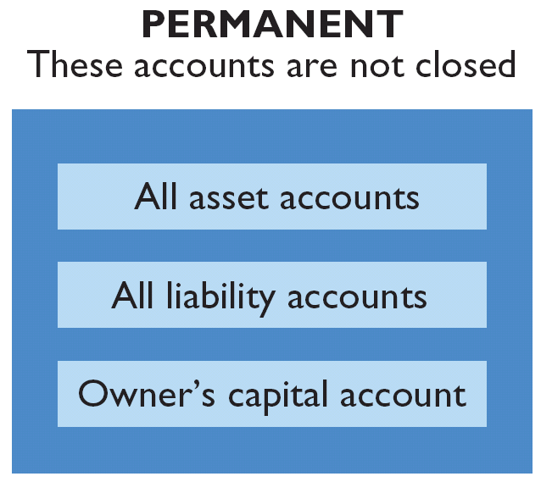
Closing the Books
At the end of the accounting period, the company makes the accounts ready for the next period.
Illustration 4-5
SO 2 Explain the process of closing the books.

Slide 23
Closing the Books
Closing entries formally recognize, in the general ledger, the transfer of
  net income (or net loss) and
  owner’s drawing
  to owner’s capital.
Closing entries are only at the end of the annual accounting period.
SO 2 Explain the process of closing the books.

Slide 24
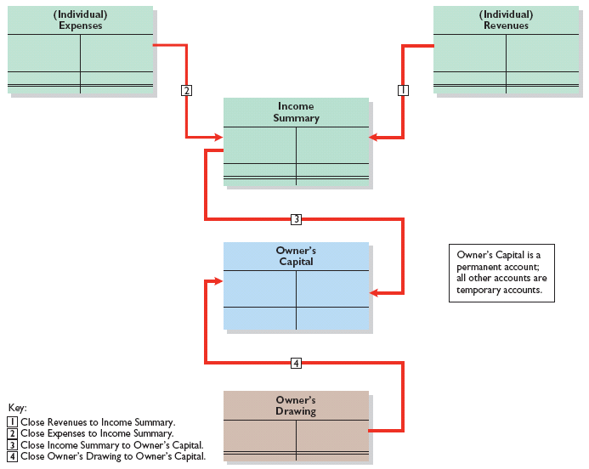
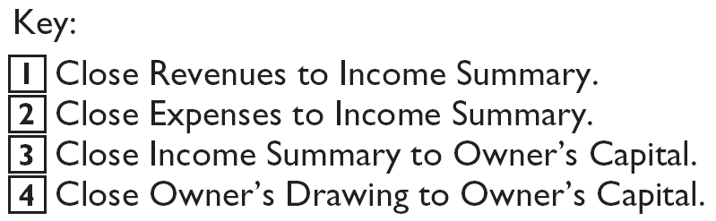
Closing the Books
Note:
Owner’s Drawing is closed directly to Capital and not to Income Summary because Owner’s Drawing is not an expense.
Illustration 4-6
Owner’s Capital is a permanent account; all other accounts are temporary accounts.
SO 2 Explain the process of closing the books.

Slide 25
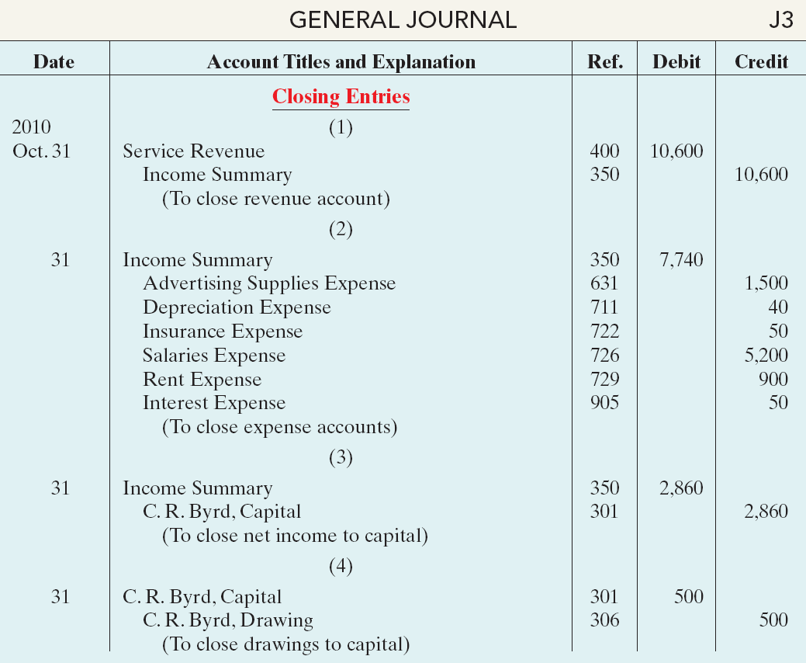
Closing the Books
Illustration 4-7
Closing entries journalized
Closing Entries need to be Posted

Slide 26
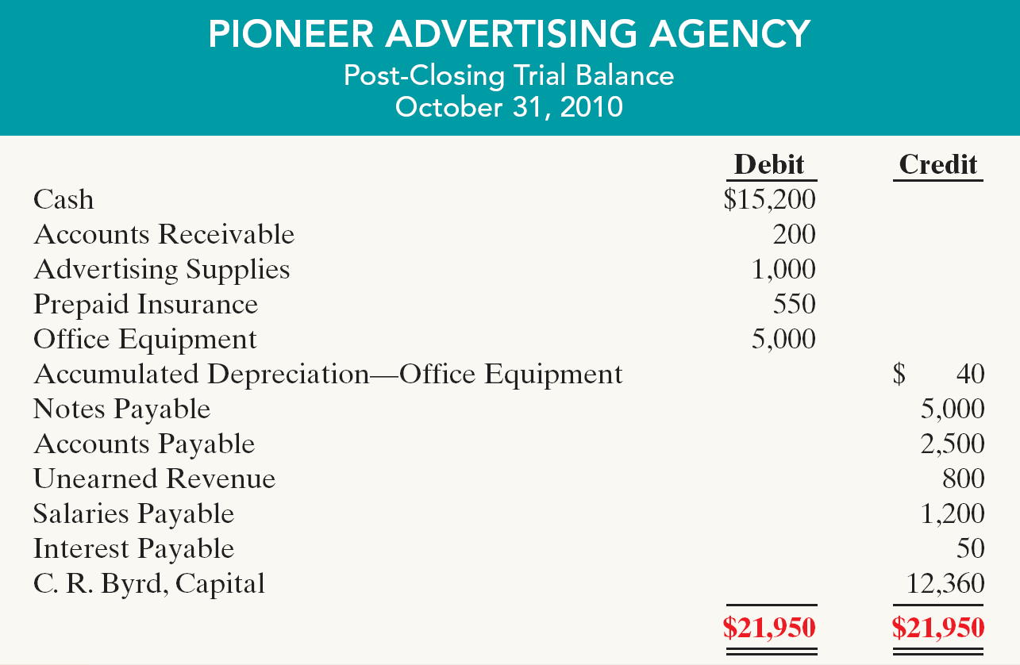
Preparing a Post-Closing Trial Balance
Purpose is to prove the equality of the permanent account balances after journalizing and posting of closing entries.
Temporary accounts will have zero balances.
Illustration 4-9

Slide 27
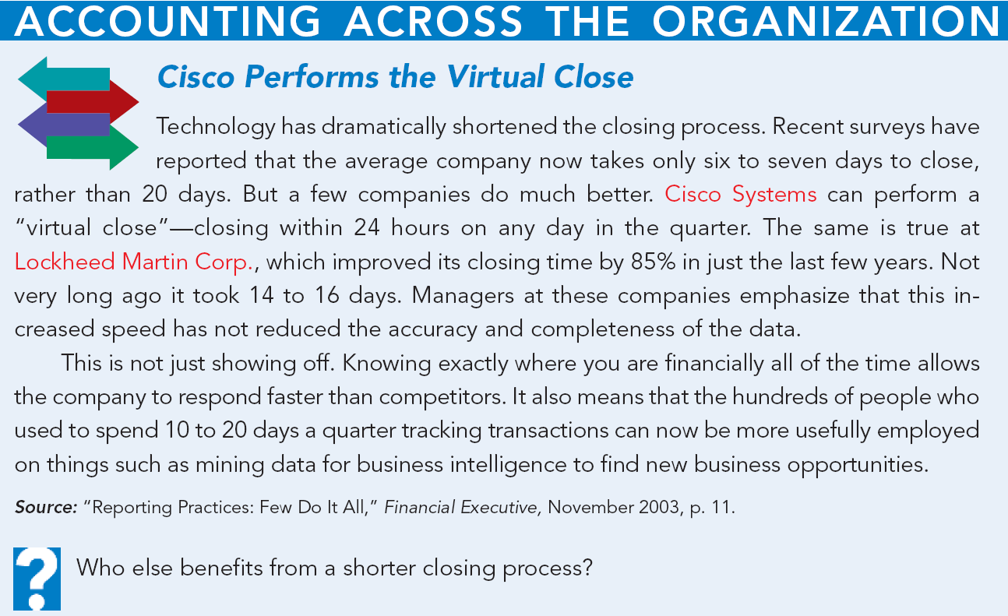

Slide 28
Summary of the Accounting Cycle
Illustration 4-12
1. Analyze business transactions
9. Prepare a post-closing trial balance
2. Journalize the transactions
8. Journalize and post closing entries
3. Post to ledger accounts
7. Prepare financial statements
4. Prepare a trial balance
6. Prepare an adjusted trial balance
5. Journalize and post adjusting entries
SO 4 State the required steps in the accounting cycle.

Slide 29
Correcting Entries—An Avoidable Step
Correcting entries
  are unnecessary if the records are error-free.
  are made whenever an error is discovered.
  must be posted before closing entries.
Instead of preparing a correcting entry, it is possible to reverse the incorrect entry and then prepare the correct entry.
SO 5 Explain the approaches to preparing correcting entries.

Slide 30
Correcting Entries—An Avoidable Step
Illustration (Case 1): On May 10, Mercato Co. journalized and posted a $50 cash collection on account from a customer as a debit to Cash $50 and a credit to Service Revenue $50. The company discovered the error on May 20, when the customer paid the remaining balance in full.
Incorrect entry
Cash 50
Service revenue 50
Correct entry
Cash 50
Accounts receivable 50
Correcting entry
Service revenue 50
Accounts receivable 50
SO 5 Explain the approaches to preparing correcting entries.

Slide 31
Correcting Entries—An Avoidable Step
Illustration (Case 2): On May 18, Mercato purchased on account office equipment costing $450. The transaction was journalized and posted as a debit to Delivery Equipment $45 and a credit to Accounts Payable $45. The error was discovered on June 3.
Incorrect entry
Delivery equipment 45
Accounts payable 45
Correct entry
Office equipment 450
Accounts payable 450
Correcting entry
Office equipment 450
Delivery equipment 45
Accounts receivable 405
SO 5 Explain the approaches to preparing correcting entries.

Slide 32
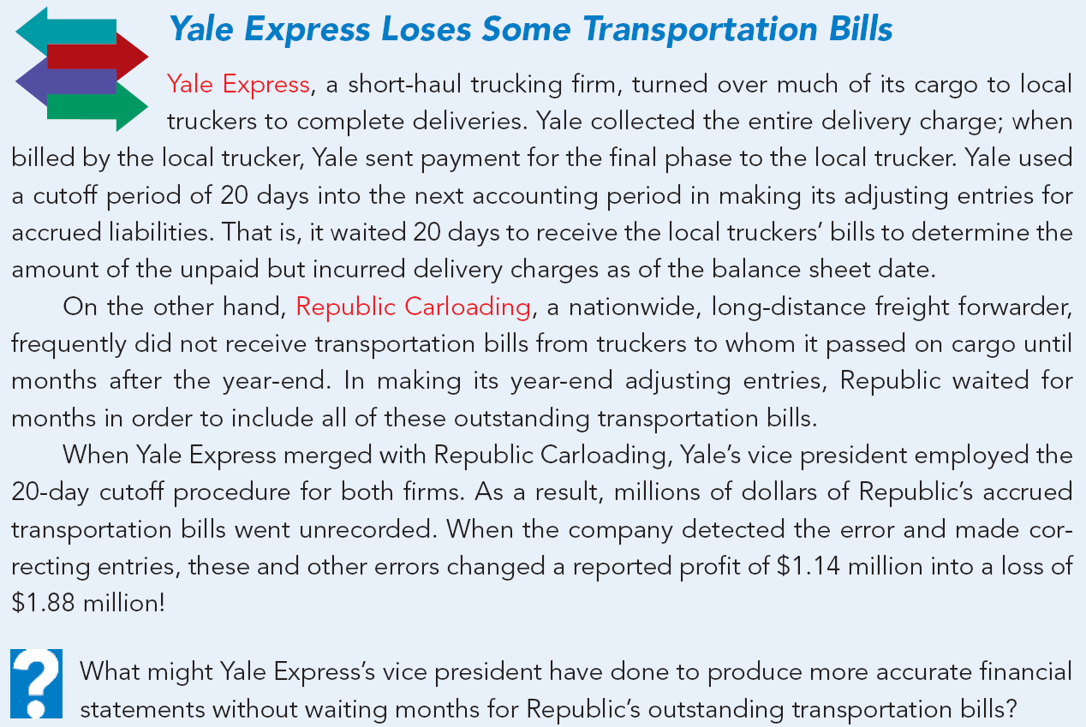

Slide 33
The Classified Balance Sheet
  Presents a snapshot at a point in time.
  To improve understanding, companies group similar assets and similar liabilities together.
Standard Classifications
Illustration 4-17
Assets Liabilities and Owner’s Equity
Current assets Current liabilities
Long-term investments Long-term liabilities
Property, plant, and equipment Owner’s (Stockholders’) equity
Intangible assets
SO 6 Identify the sections of a classified balance sheet.

Slide 34
The Classified Balance Sheet
Current Assets
  Assets that a company expects to convert to cash or use up within one year or the operating cycle, whichever is longer.
  Operating cycle is the average time it takes from the purchase of inventory to the collection of cash from customers.
SO 6 Identify the sections of a classified balance sheet.

Slide 35
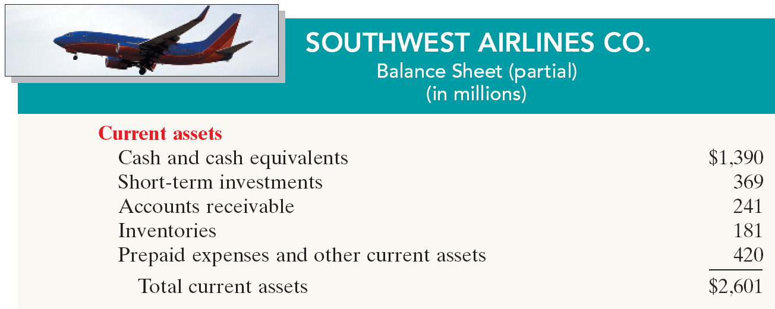
The Classified Balance Sheet
Current Assets
Illustration 4-19
  Companies usually list current asset accounts in the order they expect to convert them into cash.
SO 6 Identify the sections of a classified balance sheet.

Slide 36
The Classified Balance Sheet
Review Question
Cash, and other resources that are reasonably expected to be realized in cash or sold or consumed in the business within one year or the operating cycle, are called:
  Current assets.
  Intangible assets.
  Long-term investments.
  Property, plant, and equipment.
SO 6 Identify the sections of a classified balance sheet.

Slide 37

The Classified Balance Sheet
Long-Term Investments
  Investments in stocks and bonds of other companies.
  Investments in long-term assets such as land or buildings that a company is not currently using in its operating activities.
Illustration 4-20
SO 6 Identify the sections of a classified balance sheet.

Slide 38
The Classified Balance Sheet
Property, Plant, and Equipment
  Long useful lives.
  Currently used in operations.
  Depreciation - allocating the cost of assets to a number of years.
  Accumulated depreciation - total amount of depreciation expensed thus far in the asset’s life.
SO 6 Identify the sections of a classified balance sheet.

Slide 39
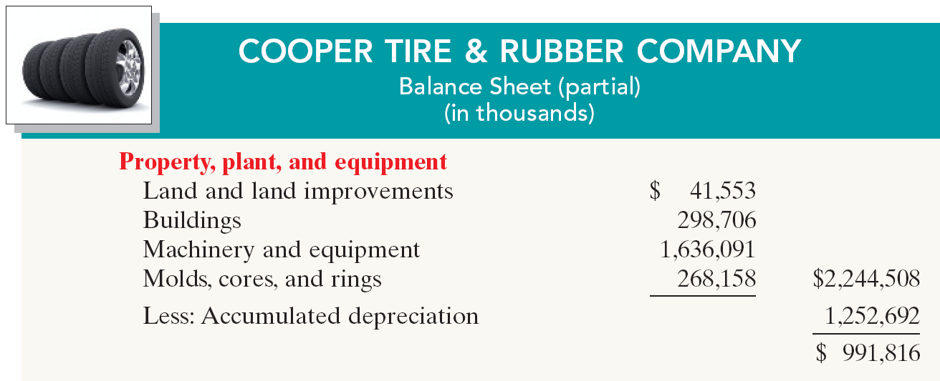
The Classified Balance Sheet
Property, Plant, and Equipment
Illustration 4-21
SO 6 Identify the sections of a classified balance sheet.

Slide 40
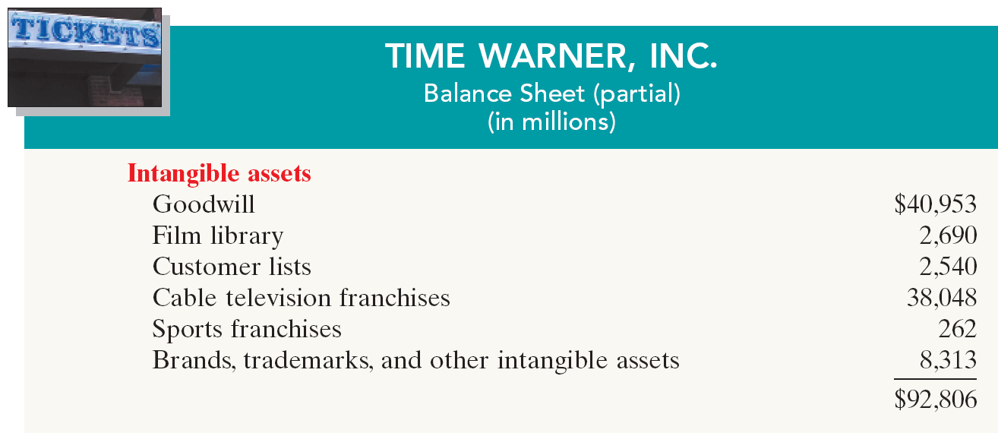
The Classified Balance Sheet
Intangible Assets
  Assets that do not have physical substance.
Illustration 4-22
SO 6 Identify the sections of a classified balance sheet.

Slide 41
The Classified Balance Sheet
Review Question
Patents and copyrights are
  Current assets.
  Intangible assets.
  Long-term investments.
  Property, plant, and equipment.
SO 6 Identify the sections of a classified balance sheet.

Slide 42
The Classified Balance Sheet
Current Liabilities
  Obligations the company is to pay within the coming year.
  Usually list notes payable first, followed by accounts payable. Other items follow in order of magnitude.
  Liquidity - ability to pay obligations expected to be due within the next year.
SO 6 Identify the sections of a classified balance sheet.

Slide 43
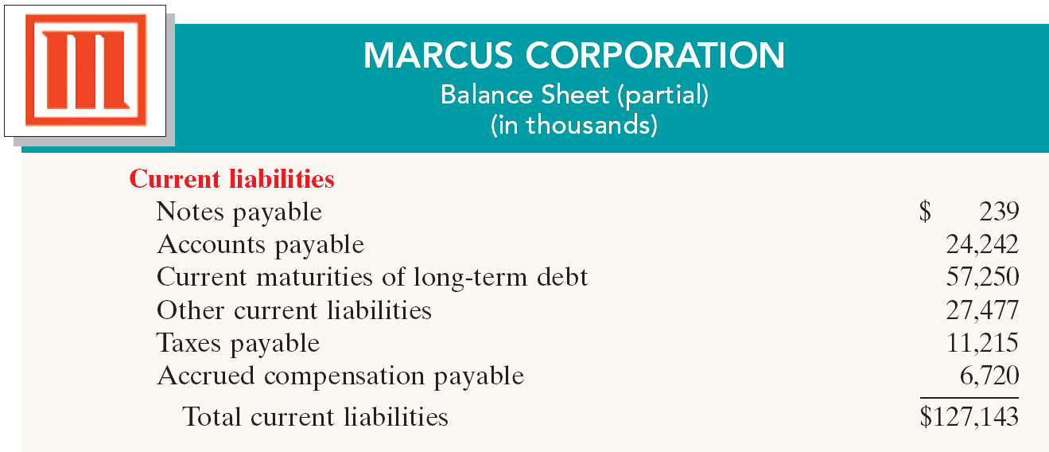
The Classified Balance Sheet
Current Liabilities
Illustration 4-23
SO 6 Identify the sections of a classified balance sheet.

Slide 44
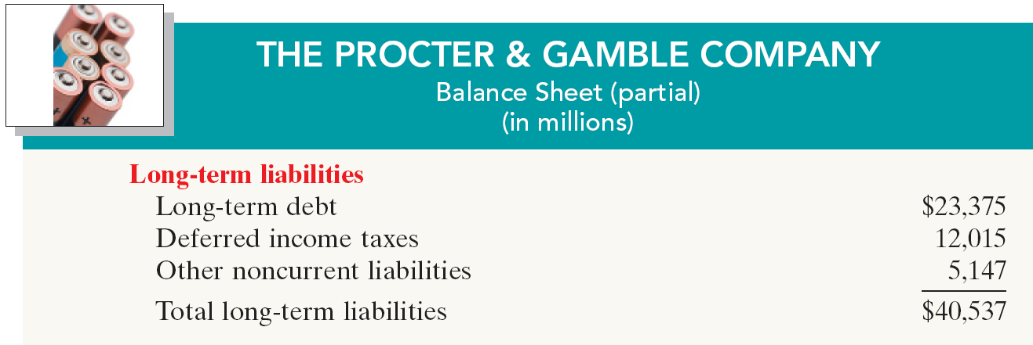
The Classified Balance Sheet
Long-Term Liabilities
  Obligations a company expects to pay after one year.
Illustration 4-24
SO 6 Identify the sections of a classified balance sheet.

Slide 45
The Classified Balance Sheet
Review Question
Which of the following is not a long-term liability?
  Bonds payable
  Current maturities of long-term obligations
  Long-term notes payable
  Mortgages payable
SO 6 Identify the sections of a classified balance sheet.

Slide 46
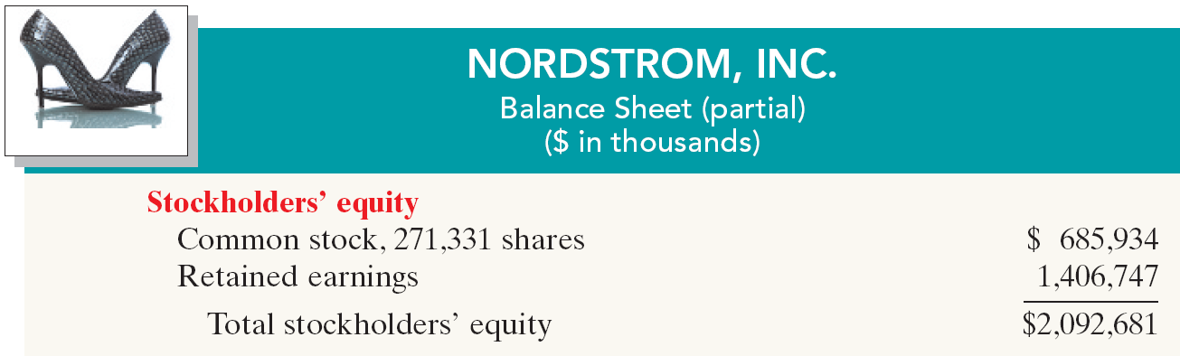
The Classified Balance Sheet
Owner’s Equity
  Proprietorship - one capital account.
  Partnership - capital account for each partner.
  Corporation - Capital Stock and Retained Earnings.
Illustration 4-25
SO 6 Identify the sections of a classified balance sheet.

Slide 47
The Classified Balance Sheet
Discussion Question
Q4-18: (a) What is the term used to describe the owner’s equity section of a corporation? (b) Identify the two owner’s equity accounts in a corporation and indicate the purpose of each.
See notes page for discussion
SO 6 Identify the sections of a classified balance sheet.
Notes:
Question 4-18 (textbook)
(a) The owner’s equity section for a corporation is called stockholders’ equity.
(b) The two accounts and the purpose of each are:
Capital stock is used to record investments of assets in the business by the owners (stockholders).
Retained earnings is used to record net income retained in the business.

Slide 48
Reversing Entries
Reversing Entries
Appendix
  It is often helpful to reverse some of the adjusting entries before recording the regular transactions of the next period.
  Companies make a reversing entry at the beginning of the next accounting period.
  Each reversing entry is the exact opposite of the adjusting entry made in the previous period.
  The use of reversing entries does not change the amounts reported in the financial statements.
SO 7 Prepare reversing entries.

Slide 49
Reversing Entries
Illustration: To illustrate the optional use of reversing entries for accrued expenses, we will use the salaries expense transactions for Pioneer Advertising Agency.
  October 26 (initial salary entry): Pioneer pays $4,000 of salaries earned between October 15 and October 26.
  October 31 (adjusting entry): Salaries earned between October 29 and October 31 are $1,200. The company will pay these in the November 9 payroll.
  November 9 (subsequent salary entry): Salaries paid are $4,000. Of this amount, $1,200 applied to accrued wages payable and $2,800 was earned between November 1 and November 9.
SO 7 Prepare reversing entries.

Slide 50
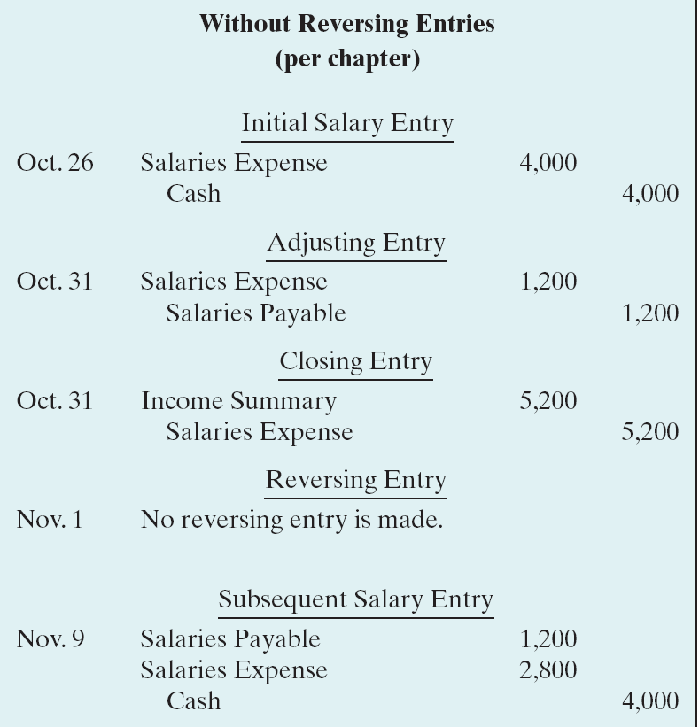
Reversing Entries
Illustration 4A-1
With Reversing Entries (per appendix)
Initial Salary Entry
Oct. 26 Same entry
Adjusting Entry
Oct. 31 Same entry
Closing Entry
Oct. 31 Same entry
Reversing Entry
Nov. 1
Salaries payable 1,200
Salaries expense 1,200
Subsequent Salary Entry
Nov. 9
Salaries expense 4,000
Cash 4,000
SO 7 Prepare reversing entries.

Slide 51
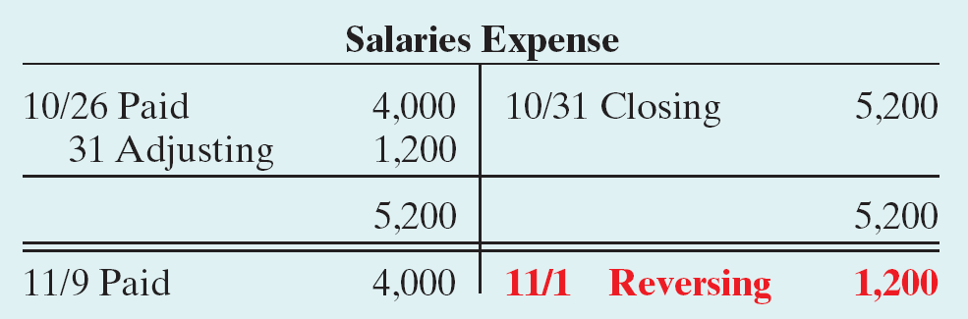
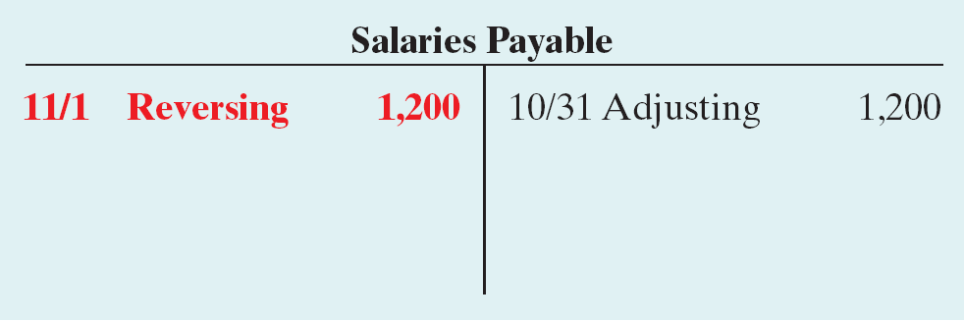
Reversing Entries
Illustration 4A-2 Postings with reversing
entries
SO 7 Prepare reversing entries.

